Slide 1


Hii, Iam Siddhika
Welcome to Power BI Series
Part -19

Slide 2

Today Content
I’m soo Excited.
Are you ready guys?
Meet DAX
IMPLICIT VS.
EXPLICIT MEASURES QUICK MEASURES

Slide 3
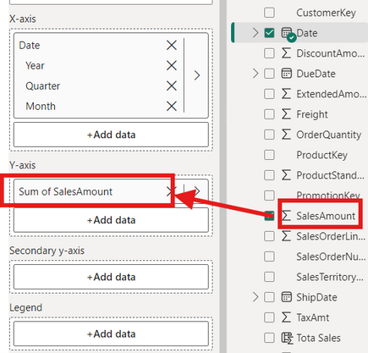

IMPLICIT VS. EXPLICIT MEASURES
Implicit measures are created when you drag raw numerical fields
into a report visual and manually select an aggregation mode (Sum,
Average, Min, Max, Count, etc.)
Have you got it?
Explicit measures are created when you actually write a DAX formula and define a new measure that can be used within the model
IMPORTANT!
Implicit measures are only accessible within the specific visualization in which they were created, and cannot be referenced elsewhere.
Explicit measures can be used anywhere in the report, and referenced by other DAX calculations to create “measure trees

Slide 4
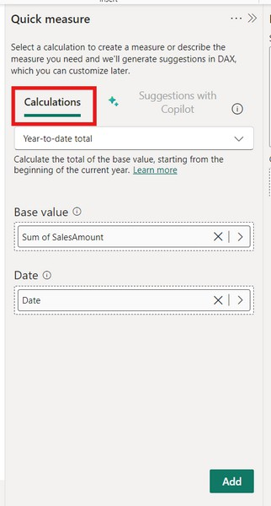


QUICK MEASURES
Quick measures automatically create formulas based on pre-built templates or natural language prompts
Check this
Quick measure calculations can be used to build measures using predefined templates (weighted averages, percent difference, time intelligence, etc.)

Slide 5


TIP:
Quick measures can be a great learning tool for beginners or for building more complex formulas . but use them with caution;
Have you tried Quick measure?
mastering DAX requires a deep understanding of the underlying theory!

Slide 6


Thank you for joining me today to learn about Part -19 of Power BI!
Remember, Learning DAX is key to unlocking the full potential of Power BI for insightful reporting and visualization.
Stay tuned for more insights and tips on Power BI in our next Series.
Follow
Siddhika Shah

